Slide 1

SOFTWARE development
GROUP PROJECT
1KGP SNP Browser – Will, Kenny, Daniella and Caterina

Slide 2
Introduction - Population Genomics
Genetic differences within and between a species
Genetic variances accrue over time
Different histories cause different patterns of polymorphisms
Single Nucleotide Polymorphisms (SNPs) are abundant genetic variations in the human genome as concluded from the Human Genome Project (Kim and Misra, 2007)
SNPs in noncoding regions, serve as significant genetic markers for comparative or evolutionary genomics studies including rebuilding a species’ demographic history (Kim and Misra, 2007)
SNPs are useful for disease genetics and pharmacogenomic studies (Kim and Misra, 2007)

Slide 3
WE MUST QUANTIFY THESE DIFFERENCES
Quantifying genetic diversity is important for understanding a specific species’ evolutional history.
So, developing a mathematical way to represent and study that genetic variation is important.
After sequencing a series of individuals, we can infer their history.
Given a dataset we can calculate summary statistics, make an inference on a species' history and distinguish between demographic models: constant size, growth and structured.

Slide 4
SOURCING POPULATION GEnomic data
Where do we find variation data?
International Genome Sample Resource (IGSR) established by the 1000 Genomes Project
Key Data fields:
REF and ALT alleles
Genotype data
Allele counts
Allele frequencies
The 1000 Genomes 30x on GRCh38 dataset: why?
https://www.internationalgenome.org/data-portal/data-collection/30x-grch38

Slide 5
Our data choices Development server framework
Chromosome 22 - lowest data storage and the smallest human autosome
Continental population granularity
2504 unrelated samples
Including only bi-allelic single nucleotide polymorphisms (SNP): why?
Does not fit genetic model of statistics calculations: Hardy-Weinberg equilibrium
Insertion and deletion polymorphisms also excluded.
Minimal information loss: only 0.2% of all SNPs are tri-allelic (Hodgkinson and Eyre-Walker, 2010)

Slide 6
Summary statistics WatTerson’s Theta
Estimated by calculating the number of polymorphic sites
A way of measuring genetic diversity in a population
A parameter of Tajima’s D

Slide 7
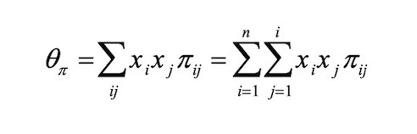
Summary statistics Nucleotide diversity
Nucleotide diversity is the sum of x_{i}x_{j}p_{ij} over all pairwise comparisons, where x is the frequency of each allele and p is the nucleotide diversity for any random pair of sequences.
Nucleotide diversity is a parameter of Tajima’s D

Slide 8

Summary statistics TAJIMA'S d - test for neutrality
The difference between the average pairwise differences and the number of polymorphisms
Comparing the differences between θπ and θW emphasizes the traits between demographic models
Growing populations: negative Tajima's D value
Constant size: the difference between θπ and θW is close to 0
Structured populations: positive Tajima's D value

Slide 9
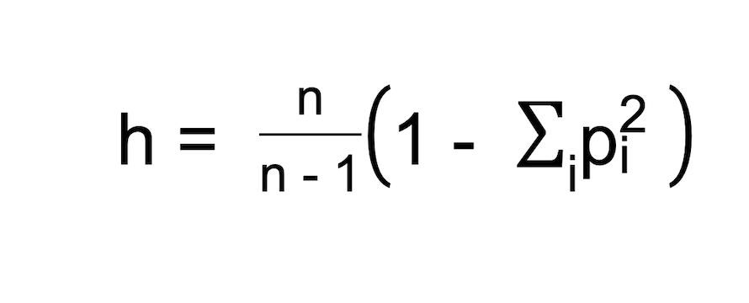
Summary statistics Haplotype diversity
What is a haplotype?
Haploid combination of alleles from more than one locus.
Haplotypes are caused by evolution via mutations and recombination.
Haplotype diversity is the probability that two randomly chosen haplotypes are different, where pi is haplotype frequency of each haplotype and n is the sample size

Slide 10

Summary statistics F_{st} - Hudson’s estimator
F_{st} is the correlation amongst randomly chosen alleles between two given populations, (Bhatia etal., 2013).
Hudson's estimator Fst estimates impartially the variance between two populations.
It is a simple average of the population-specific estimators according to the Weir and Hill (2002).

Slide 11
Summary statistics Derived allele frequency
What is a derived allele?
A derived allele is a variant that has arisen since the last common ancestor.
Where did the data come from?
Ancestral sequence retrieved from ensembl release 105 ftp site.
How was DAF calculated?
Allele frequencies are given for REF and ALT alleles
Given bi-allelic SNPs, total probability space sums up to 1.
What does DAF mean?
Signifies the proportion of ’mutated’ alleles (relative to the ancestor) in a population.

Slide 12
BIOINFORMATICS SOLUTION
Demonstration
Basic Functionality

Slide 13



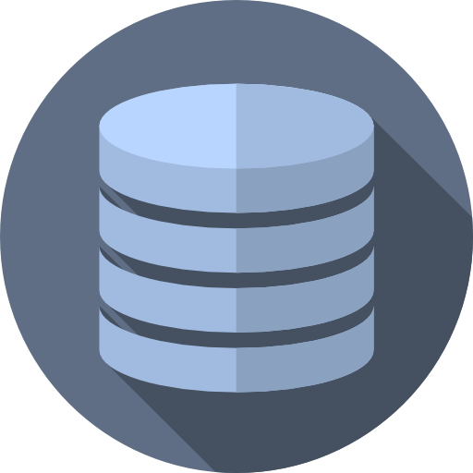
Software architecture - Overview
Web App
App Logic:
Python – Flask,
SQLAlchemy
Input query
Request
Return/ Display Results
Response
Users
Frontend
Python - Dash, HTML, CSS, Javascript
Query-Specific Files
csv, VCF, H5, npy
Zarr Storage
Genomic Data
(VCF Files)
Backend

Slide 14

Database Management Zarr
What is Zarr?
A storage format designed to compress and chunk large datasets
Designed with parallelization and cloud storage in mind
Embedded within scikit-allel's functionality:
VCF conversion to Zarr
Compression throughout

Slide 15
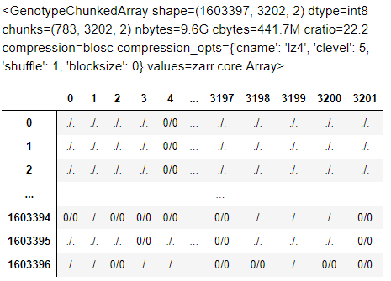
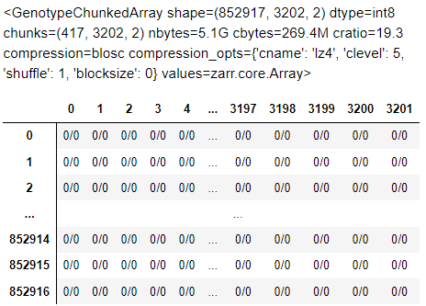

Database Management Zarr
How does it impact the data?
Genotype Array Phased Genotype Array
Splits data into chunks

Slide 16

Database Management Zarr
How does it impact the data?
Genotype Array Phased Genotype Array
Uncompressed Size

Slide 17

Database Management Zarr
How does it impact the data?
Chunked Genotype Array Chunked Phased Genotype Array
Chunked, Compressed Size
Saving 13.9Gb of Storage

Slide 18
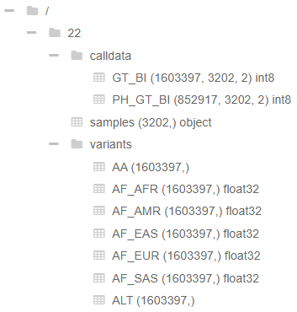
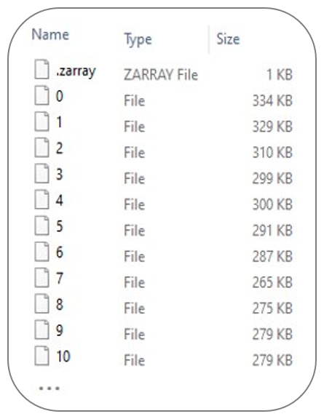
Database Management Zarr
Zarr Folder Structure
Subfolder Chunks
Other benefits:
Hierarchical File Structure
Lazy loading
Disk storage capabilities

Slide 19

Web framework flask
What is Flask?
A lightweight python web framework
Popular – Used by Netflix, Airbnb and Uber
Why choose Flask?
Highly scalable
Straight-forward to learn and deploy
Open source third party libraries add flexibility and customization

Slide 20

Data Visualization Dash
What is Dash?
An interactive dashboard framework
Why choose Dash?
It is an extension of Flask – seamless integration
Python-based interface
Extensive customization – Plotly, CSS, Dash Core Components

Slide 21
BIOINFORMATICS SOLUTION
Demonstration
Advanced Functionality
1kgpsnpbrowser.rf.gd

Slide 22
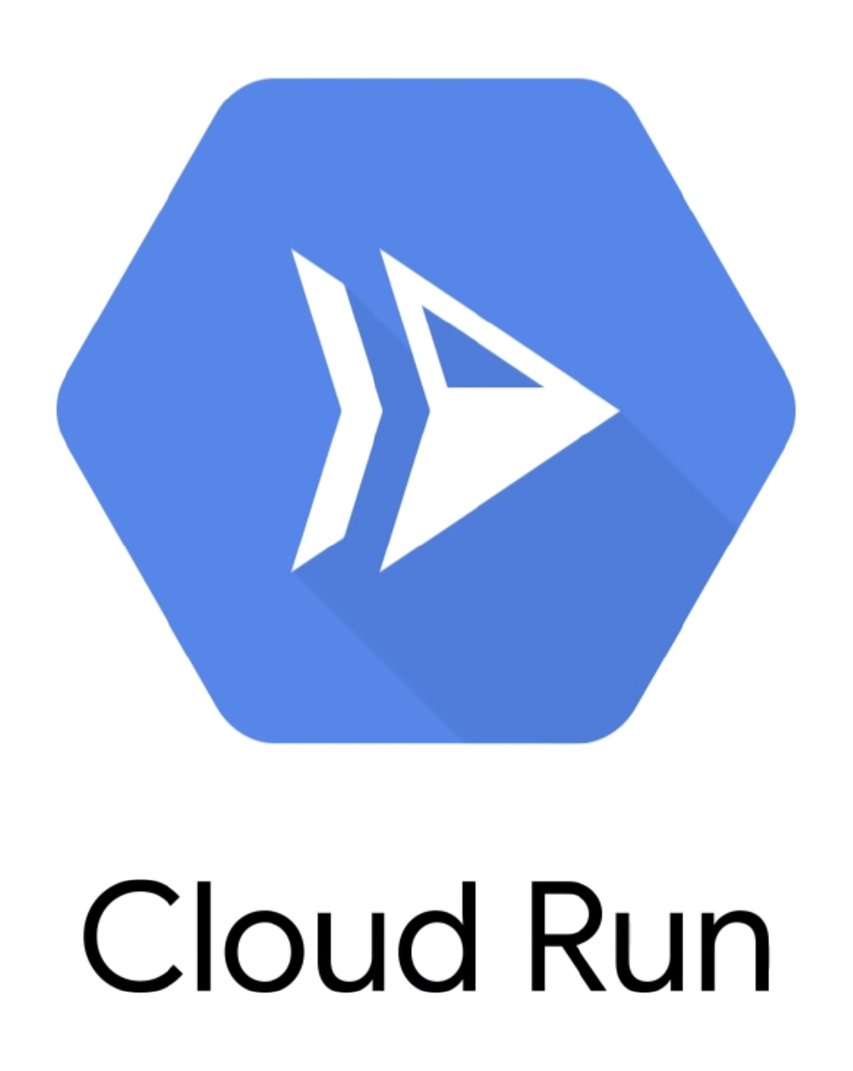
HOSTING Google cloud run
What is Google Cloud Run?
A service on the Google Cloud Platform.
Allows developers to deploy any code packaged as a Docker container.
Abstracts away all infrastructure management.
Compatible with any language, including Python with Flask.
1kgpsnpbrowser.rf.gd

Slide 23
References
Kim, S. and Misra, A., 2007. SNP Genotyping: Technologies and Biomedical Applications. Annual Review of Biomedical Engineering, 9(1), pp.289-320.
Grinberg, M., 2018. Flask Web Development. 2nd ed. Sebastopol, California: O’Reilly Media, Inc.
Rezaei, N. and Hedayat, M., 2013. Allele Frequency. Brenner's Encyclopedia of Genetics, pp.77-78.
Bhatia G., Patterson N., Sankararaman S., and Price A. (2013) ‘Estimating and interpreting Fst: The impact of rare variants’, Genome Research, 23(9), pp. 1514-1521. doi: 10.1101/gr.154831.113
Hodgkinson, A. and Eyre-Walker, A. (2010) ‘Human Triallelic Sites: Evidence for a New Mutational Mechanism?’, Genetics, 184(1), pp. 233–241. doi:10.1534/genetics.109.110510.

